Slide 1
Cafe Coffee Night
Karthiheswar M

Slide 2
Exploratory Analysis of data & an executive summary of top findings, supported by graphs

Slide 3
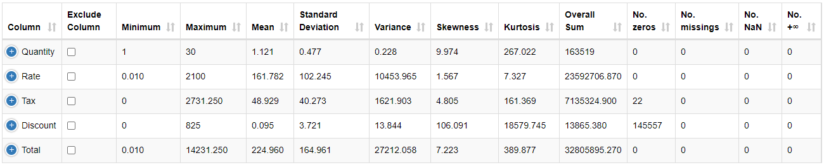
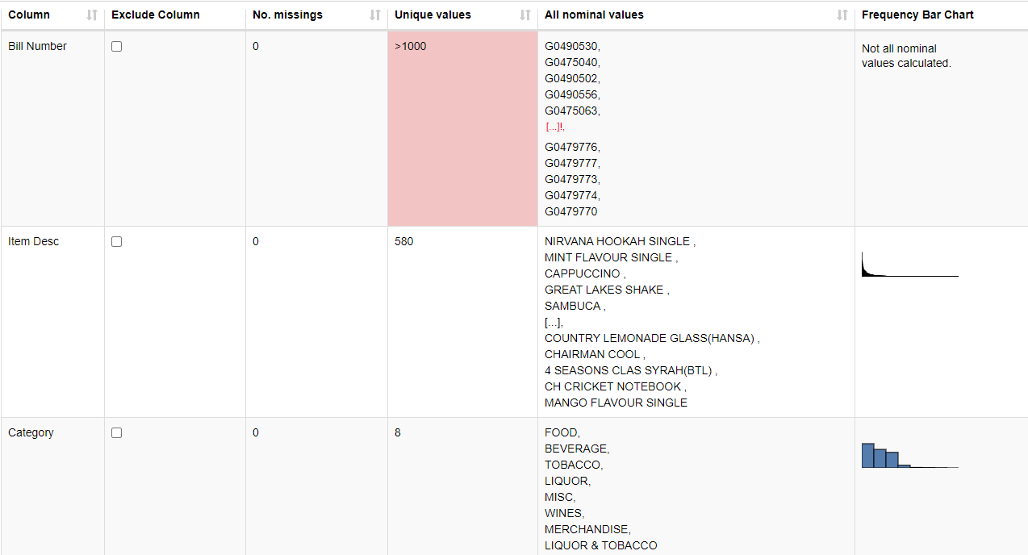
Exploratory Data Analysis

Slide 4
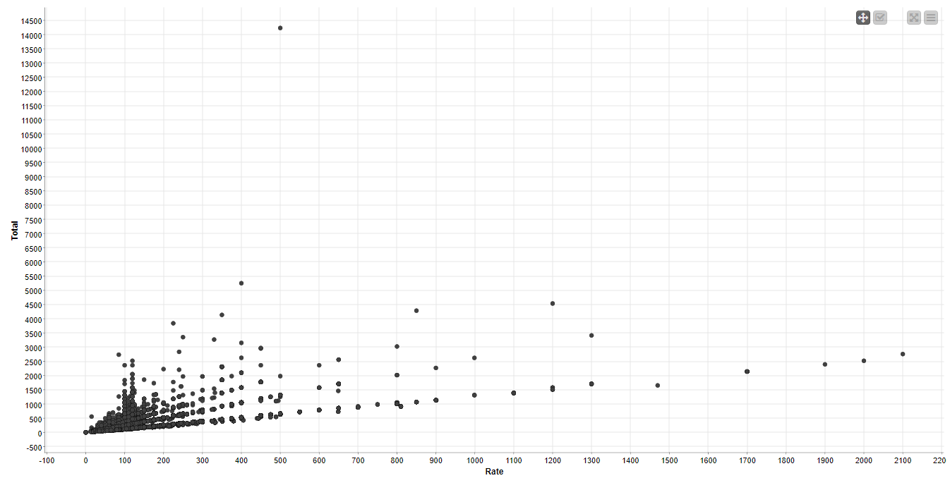
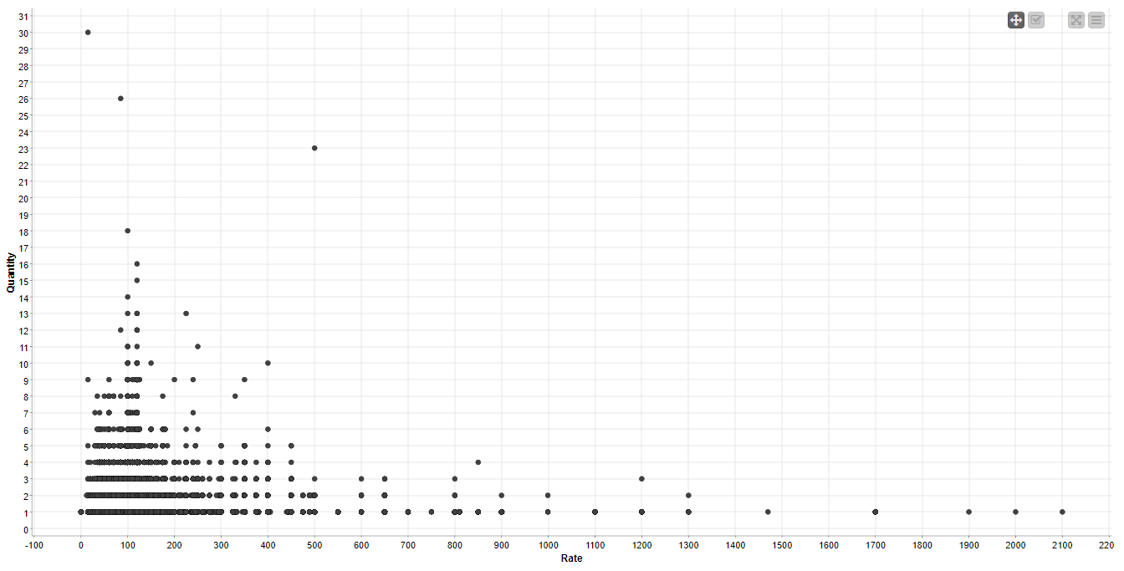
Bivariate Analysis on Rate vs Total and Rate vs Quantity
A linear relationship can be noted between Rate and Total
Item description with lower price has sold most with small Total individually, i.e, there are large amount of small Total transactions where the Item description with higher rate has sold less which means there are less amount of high Total transactions

Slide 5
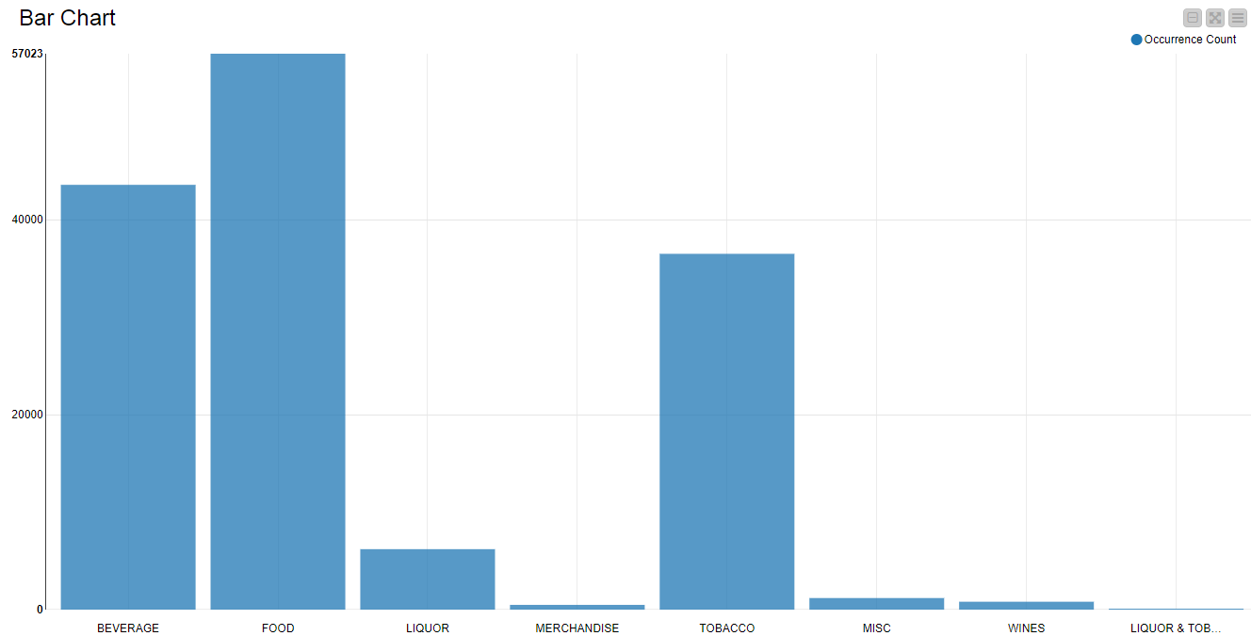
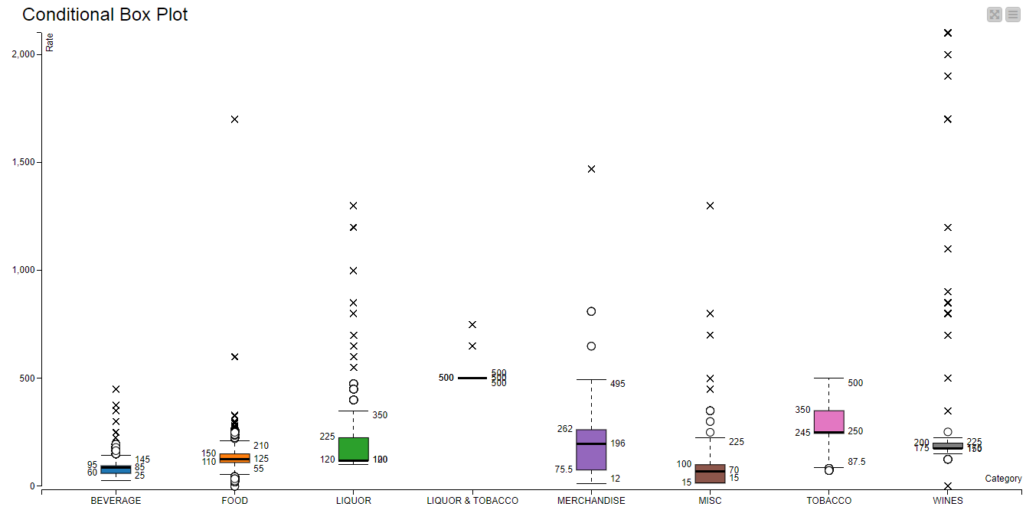
Univariate Analysis on Category and Conditional Box plot on Category vs Rate
Item description under Food category has sold best followed by Beverage. Liquor & Tobacco performs least sales, also Merchandise, Misc and Wines shows poor sales
Items in Wines have higher rates where Items in Beverage and Food has lower rates apart from few Items

Slide 6
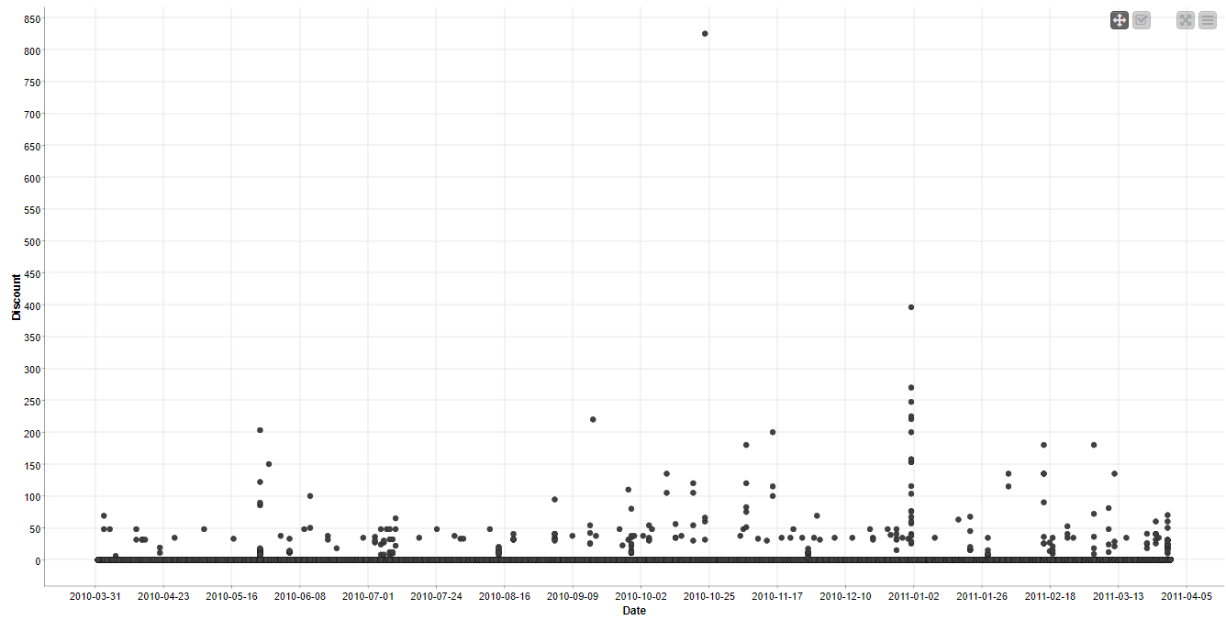
Bivariate Analysis on Date vs Discount
The above plots doesn't show any relation between Date and Discount but in few dates we can see some higher discounts but it can also may be because of Item description

Slide 7
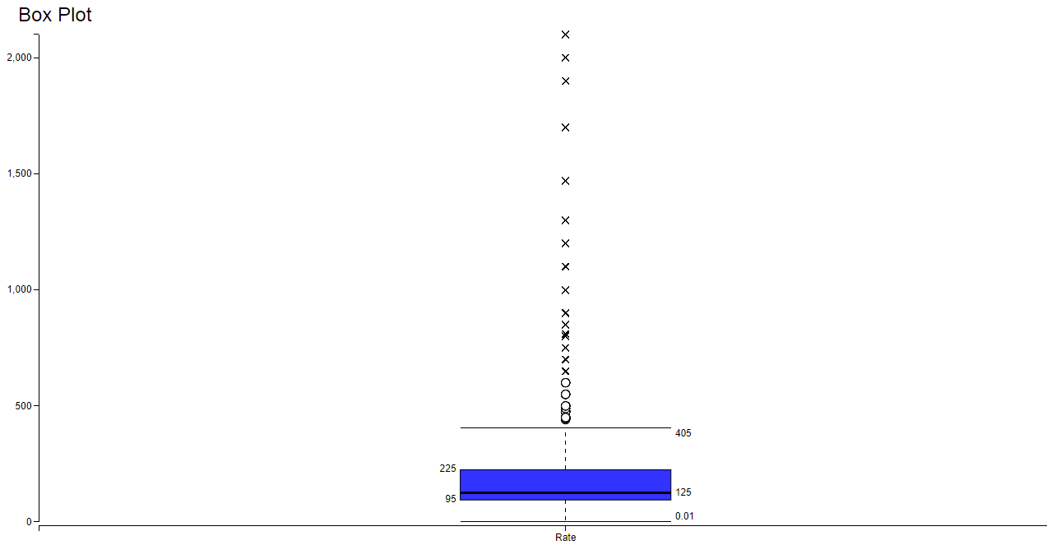
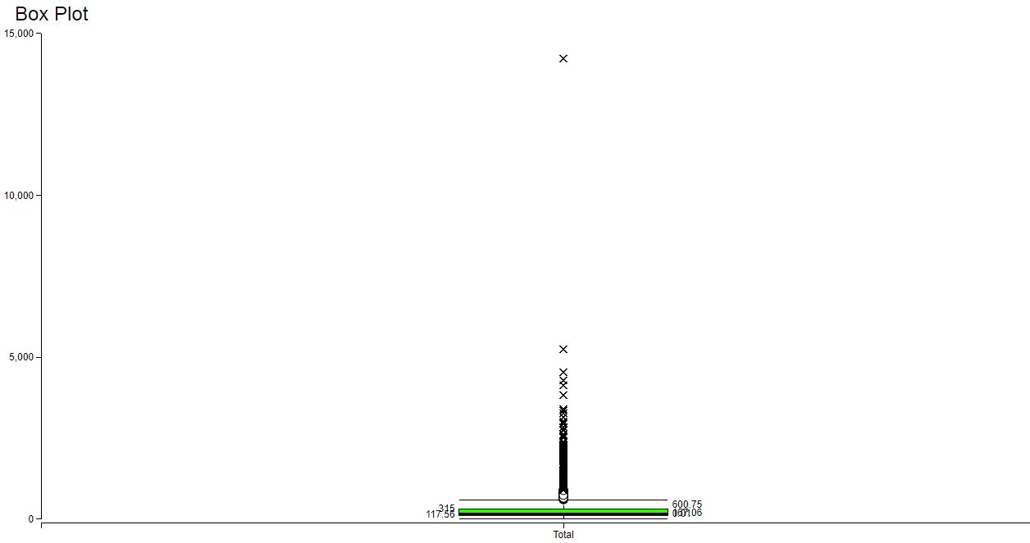
Box plot on Rate and Total
Rate of Item description doesn't lie in some particular range, the price of each Items varies induvidually where the Total has some particular range within which the most of Total spent occurs
Only a particular Total has reached nearly 15000

Slide 8
Kind of trends noticed in terms of consumer behavior over different times of the day and different days of the week, also some concrete recommendations based on the same

Slide 9
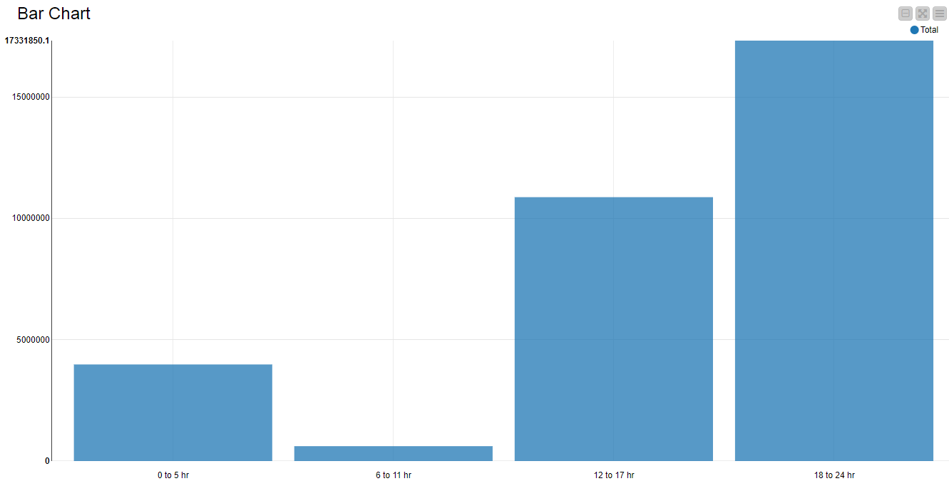
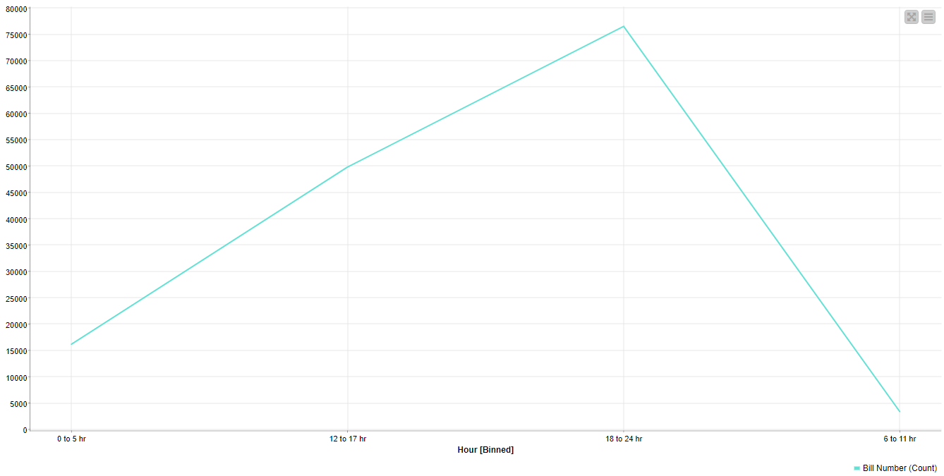
Trends noticed in terms of consumer behavior over different time range of the day
Consumers made highest number of transactions and highest Total during 18 hr to 24hr followed by 12 hr to 17 hr
Consumers have made least number of transactions and least Total during 6 hr to 11 hr
So least important service can be made during 6 hr to 11 hr
0 hr to 5 hr has second least transactions made, so few more steps can be made to improve the transcations during this period

Slide 10
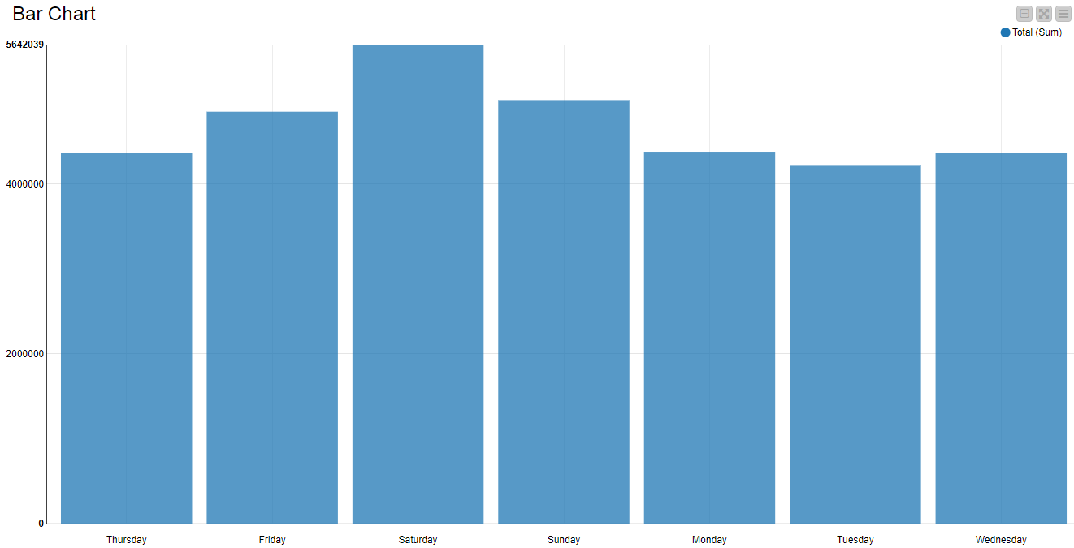
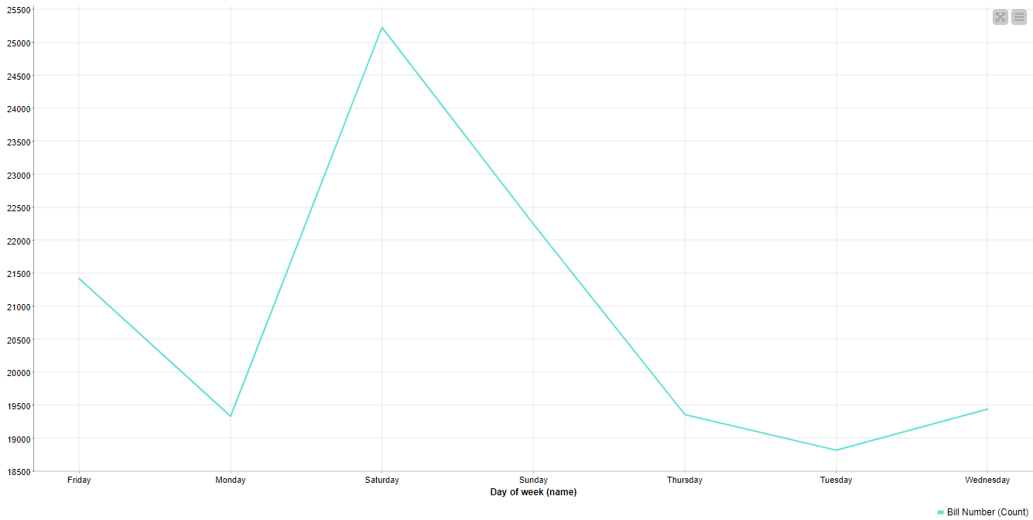
Trends noticed in terms of consumer behavior over different days of the week
Consumers made highest number of transactions and highest Total on Saturday followed by Sunday
Consumers have made least number of transactions and least Total on Tuesday
Even though the no. of Bill counts varies hugely between different days, Total amount doesn't varies much
Some speacial offers exclusively on Tuesday can be made to improve the revenue on Tuesday

Slide 11
Certain menu items that can be taken off the menu

Slide 12
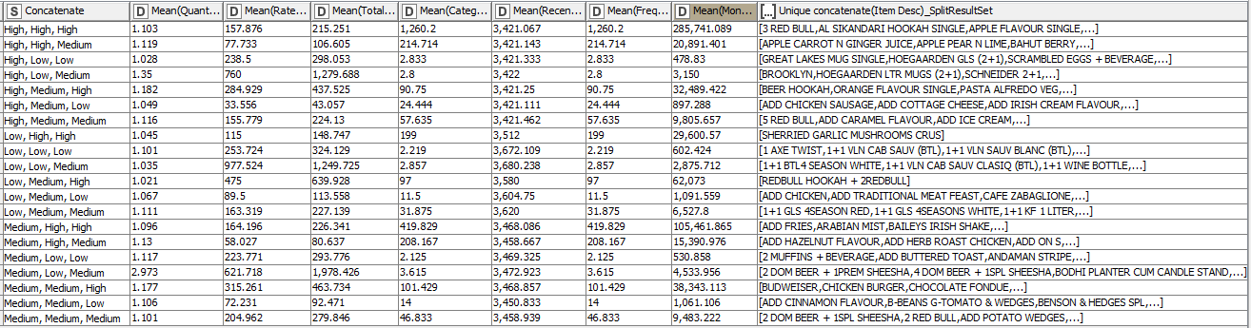
RFM Analysis on Item Decsription

Slide 13
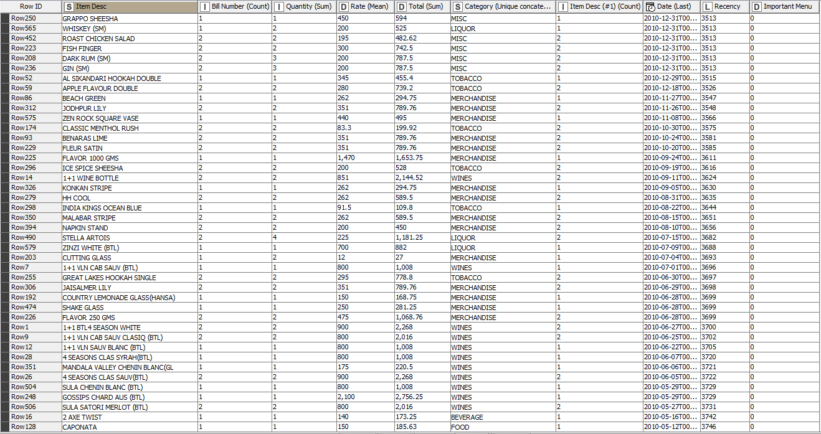
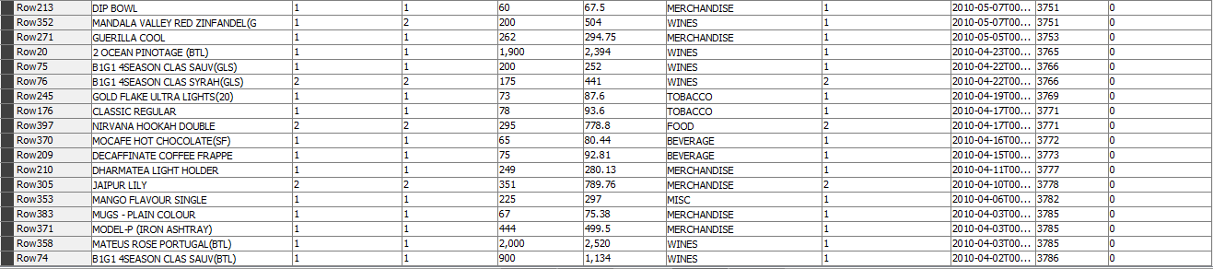

Slide 14
The above listed Item descriptions have transactions less than 3 times, has Total sum of less than 3000 and very low recency value of greater than 3512 days (3512 is the lowest mean receny value amoung low recency bin calculated from RFM analysis). So these Items can be removed from the menu
Also1 Axe twist, 1+1 VLN Cab SAUV (BTL), 1+1 VLN Cab SAUV BLANC (BTL) and few more items has least recency, monetary and frequency value. So these are unnecessary items which can also be removed from the menu
Note: The concatenate values of RFM analysis are in order of Recency, Frequency and Monetary

Slide 15
Trends across the months

Slide 16
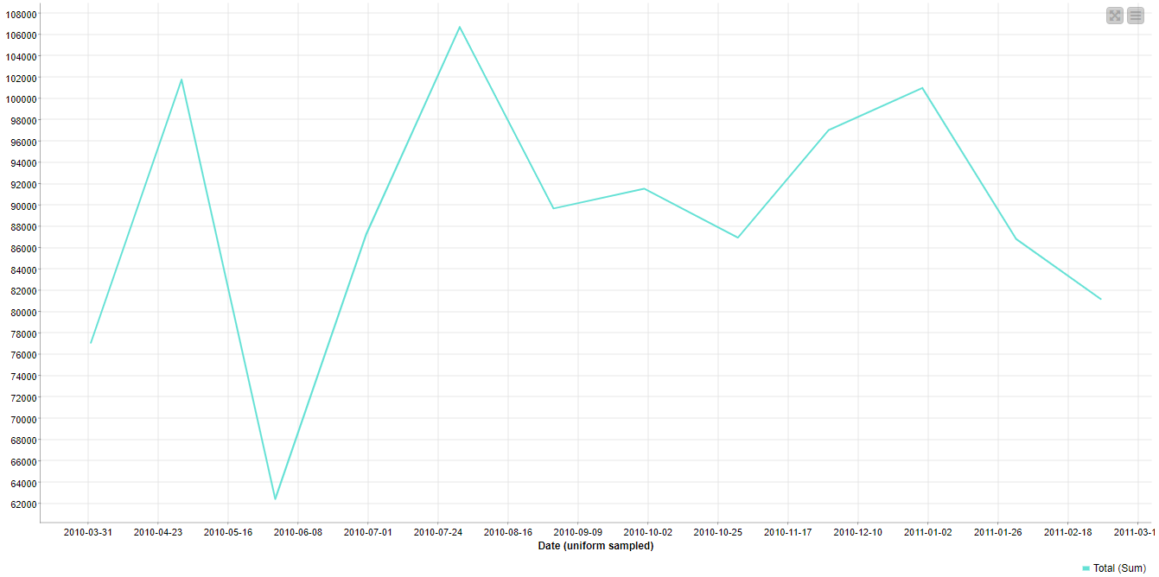
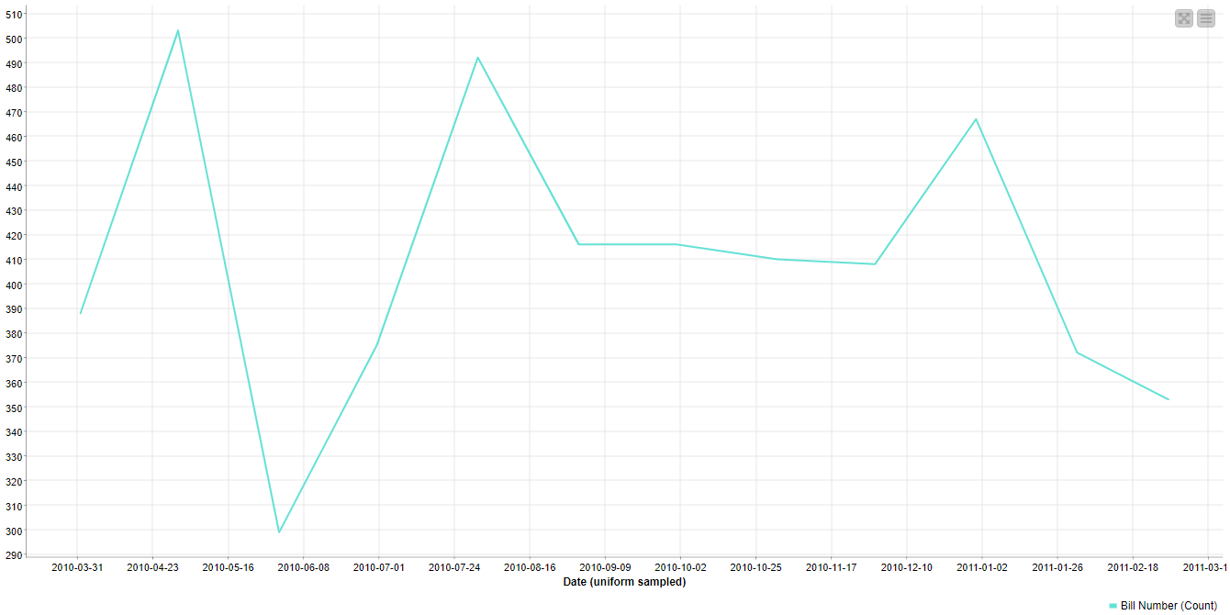
Trends of Total sum and Bill count across months
At month of end of May to first week of June there is huge drop in Total sum and Bill counts. So more attractions and special attention has to be made during this period to improve the transactions
By the end of April the Total and Bill counts it declines till June, after June it again starts inclining
During August, Total sum has most peak values and at end of April, Bill count has most peak values

Slide 17
Most popular combos to be suggested to the restaurant chain after a thorough analysis of the most commonly occurring sets of menu items in the customer orders

Slide 18
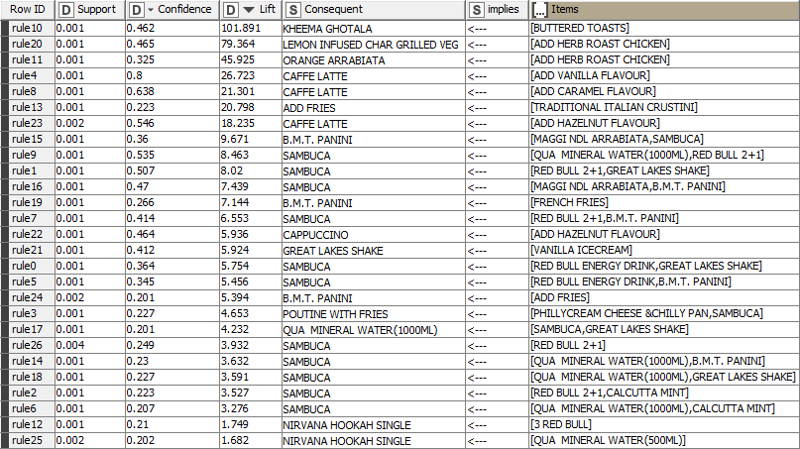
Association Rules
The above Items are ordered together at higher number of times
Kheema ghotala with Buttered toasts has highest lift value followed by Lemon infused char grilled veg with dd herb roast chicken, however these combos sounds like toppings
B.M.T Panini with Maggi NDL Arrabiata and Sambuca combo has high lift
Likewise these Items above can be made combo with their respectives

Slide 19
RFM Analysis on Item Decsription
3 Red Bull, Al Sikandari Hookah single, Apple flavor single and few more items are bought most frequently, has high monetary value and has high recent transaction. So these are the cafe's key items and which should be maintained in quality and shouldn't be unavailable
1 Axe twist, 1+1 VLN Cab SAUV (BTL), 1+1 VLN Cab SAUV BLANC (BTL) and few more items has least recency, monetary and frequency value. So these are unnecessary items that can be removed from the menu
2 Dom Beer+1 SPL Sheesha, 2 Red Bull, Add Potato Wedges and few more items has medium recency, monetary and frequency value. So these items requires attention to improve the sales to next level
Therefore, combos can also be made by combining some high frequency Items with low recency Items and combos with high recency items with low frequency Items with appropriate Items
Note: The concatenate values are in order of Recency, Frequency and Monetary

Slide 20
Cluster Analysis on Item Decsription
Cluster_4 has made high Total average with least no. of Bill counts, also can be nicknamed as Premium customers as they have highest Rate average. So Items in this cluster are very important for the cafe
Cluster_0 has made least revenue so these Items can be least bothered Items as their Quantity average and Rate average is also low
Even though Cluster_1 has highest no. of Bill counts their Total average, Rate average and Quantity average are comparitvely very low. So these Items rate has to be revised to increase the revenue
Cluster_2 and Cluster_3 are the medium rated customers
To make our Premium customers more comfortable, Items in Cluster_4 can be made as combo with appropriate and can be named as Premium combo
Combos can be made with Items in Cluster_0 and Cluster_1 to improve the Total and Quantity sold

